Slide 1
Contact App Management System
This presentation introduces a robust contact management system built with React-Native and SQLite. It leverages the power of mobile-first development and local data storage for efficient contact management.
Adarsh Gupta (Associate Engineer)

Slide 2
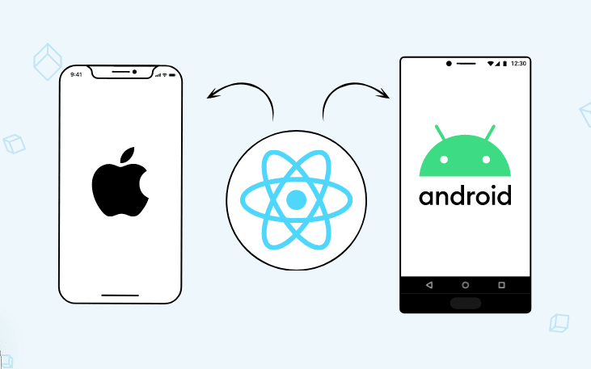
Overview of React-Native and SQLite
React-Native - React-Native enables cross-platform development, allowing us to build native-like apps for both iOS and Android using JavaScript.
SQLite – SQLite provides a lightweight and efficient local database solution, enabling us to store and manage contact data directly on the device.

Slide 3
Key Features of the Contact App
Adding Contacts | Viewing Details | Managing Contacts
Users can easily add new contacts by entering their name, phone number and other relevant information. They can also upload an image or capture a photo directly from the app. | The app provides a comprehensive view of each contact, including their profile picture, name and phone numbers. | Users can organize contacts into groups for efficient management and quick access to specific contacts. To edit or delete a contact, simply swipe left on the group name.

Slide 4
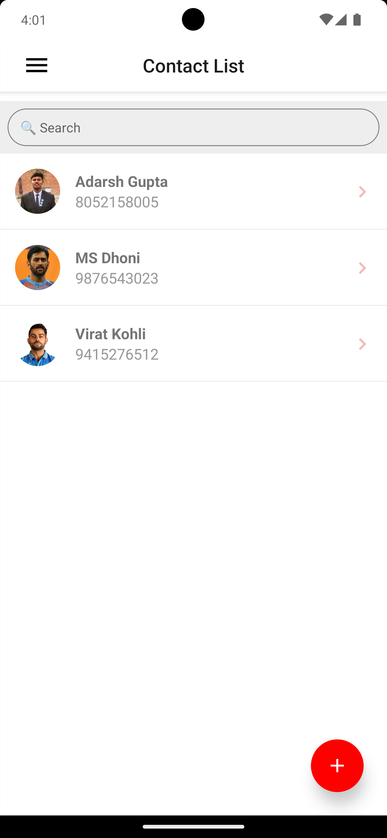
User Interface Design and Navigation
Contact List
The main screen displays a list of all contacts, allowing users to quickly access and manage their contacts
Contact Details
Users can tap on a contact to view their detailed information, including their phone number, name, and other relevant data.
Add Contact
A dedicated screen allows users to easily add new contacts to their list.
Search Functionality
Users can quickly find a specific contact by searching their name.

Slide 5
Implementing CRUD Operations
Create
Read
This involves adding new contacts to the database with their relevant information.
This allows users to view existing contacts and their details from the database.
Update
Delete
Users can modify existing contact information, such as name, phone numbers or profile picture.
Users can remove contacts from the database permanently.

Slide 6
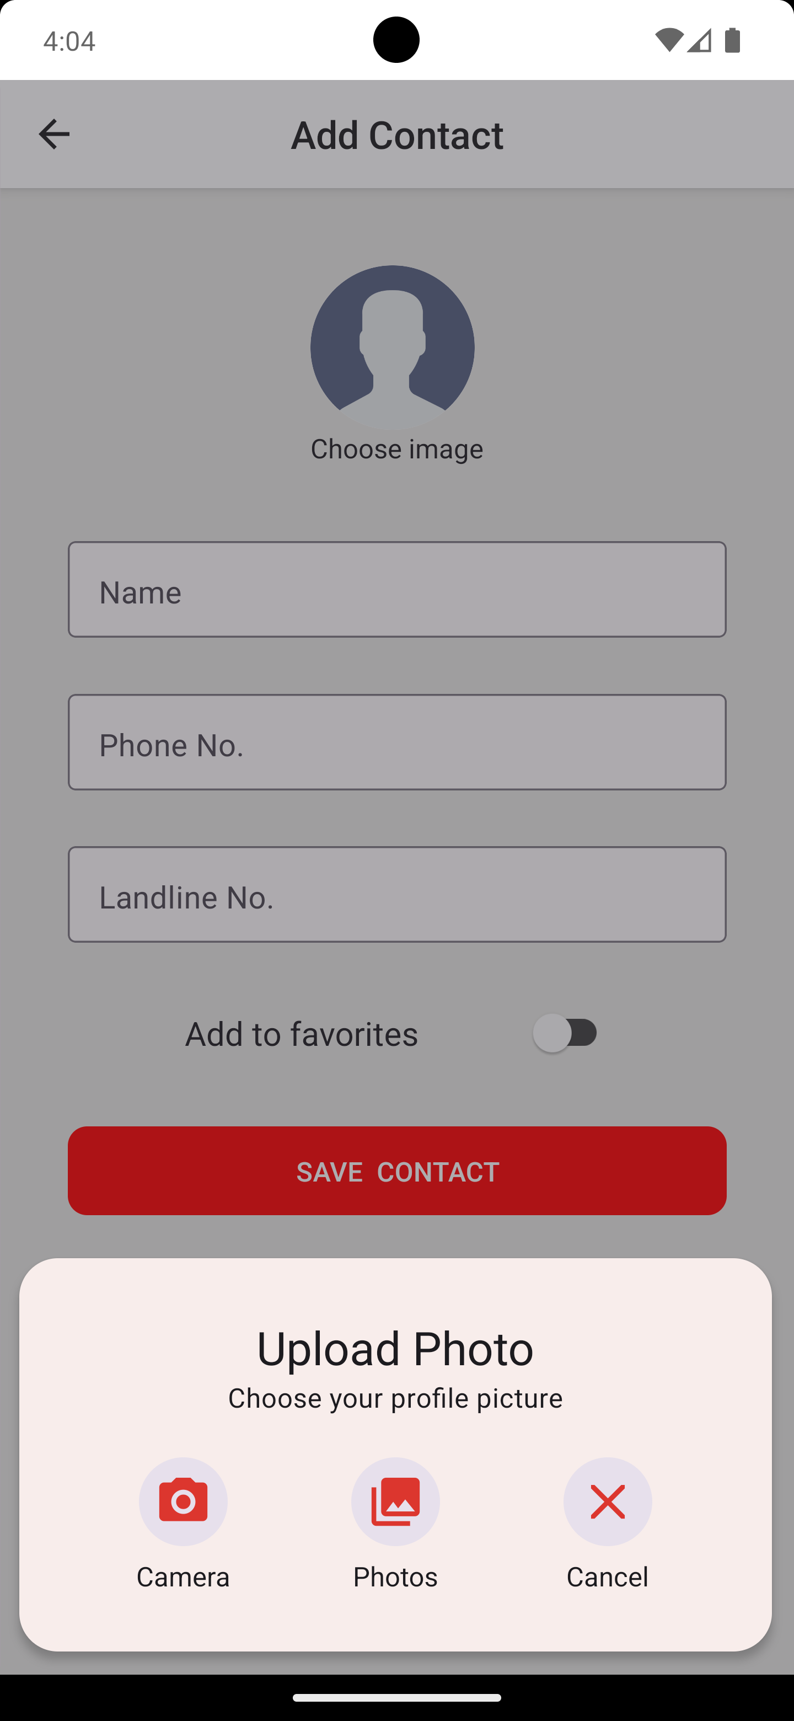

Add Contact Page
Enhancing user interaction with React-Native Features
Capture Information
Utilize react-native-image-picker for Image Upload
Field Validation
Collect essential contact details to create a comprehensive user profile.
Facilitate users to upload profile pictures seamlessly using a popular image picker library.
Real-time validation to ensure accurate and complete contact information.
Add to Favorite Functionality
Integrate MODAL Component for Image Upload
Enable users to mark contacts as favorites for quick access and prioritization.
Enhance user experience by incorporating a modal component for image uploads or live capturing.

Slide 7
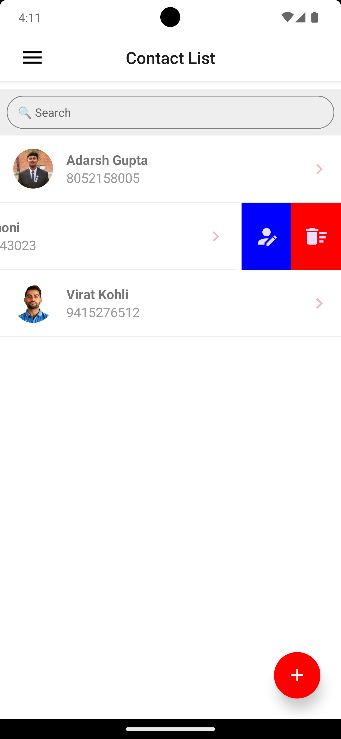
Edit & Delete Contacts
Enhancing user interaction with React-Native Features
Implement Left Swipe Gesture
Edit and Delete Options
Utilize react-native-swipe-list-view library to enable left swipe functionality for enhanced user experience.
Provide edit and delete buttons on each contact card to allow users to modify or remove contact details conveniently.
Delete Contact Functionality
Update Contact Information
Incorporate delete functionality to allow users to remove unwanted contacts effortlessly from the app.
Enable users to update contact details seamlessly, ensuring data accuracy and relevance.

Slide 8
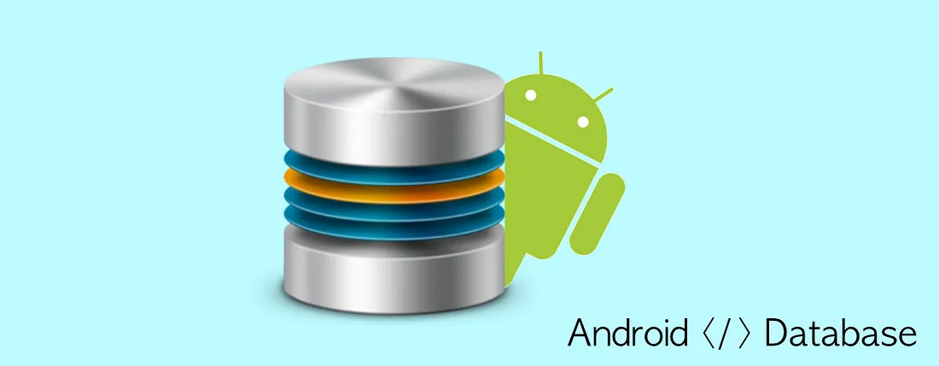
Usage of SQLite for local storage
Implementing SQLite for efficient and secure data storage on the device
Data persistence and offline capability –
Ensuring data consistency and accessibility even in offline
scenarios, enhancing user experience.
Storing and managing contacts locally -
Enabling users to save and organize contacts directly on their
device for quick access.

Slide 9
Future Development Plans
Enhancing user interaction with advance Contact Management
Backup and Restore Contacts -
Allow Users to backup their contacts to the cloud or a file, and store them easily if they lose their device or data.
Birthday and Anniversary Reminders -
Add a feature to remind users of their contact’s birthdays and anniversaries.
Sharing Contacts -
Enables users to share contacts with others via email, SMS, or social media.

Slide 10

Adarsh Gupta
Associate Engineer
adarsh.gupta@nagarro.com
github.com/adarshgupta0040

Slide 11
Thank You

